Slide 1
Team 4 Predicting Defaults
Chance Pickett, Clara Smith, Addison Wilson

Slide 2
Understanding the Problem
Default
Period between delinquency and charge-off
Includes late fees and a higher interest rate
Costs
Repossess collateral such as vehicle, boat, or home
Unsecured debts give creditors limited recourse
Charged Off
Charges off when the account goes unpaid for 120 to 180 days
Interest, fees, and penalties stop
Costs
Lenders seize collateralized debt and sell it
Damage to credit is done

Slide 3
Client Goals
Understanding who is applying and who is successful
Market to individuals looking for a loan
Understanding which loans are successful and which aren’t
Reach out to individuals with “unsuccessful” qualities
Gather important findings and insights about the customer base
Create recommendations

Slide 4
Data Summary
887,379 loans and their information from LendingClub
1,219 “Default” loans
45,248 “Charged Off” loans
1,598,3120 null values
Variables with most null values
Dti_joint, 886,870 null values
Annual_inc_joint, 886,868 null values
Verification_status_joint, 886,868 null values

Slide 5
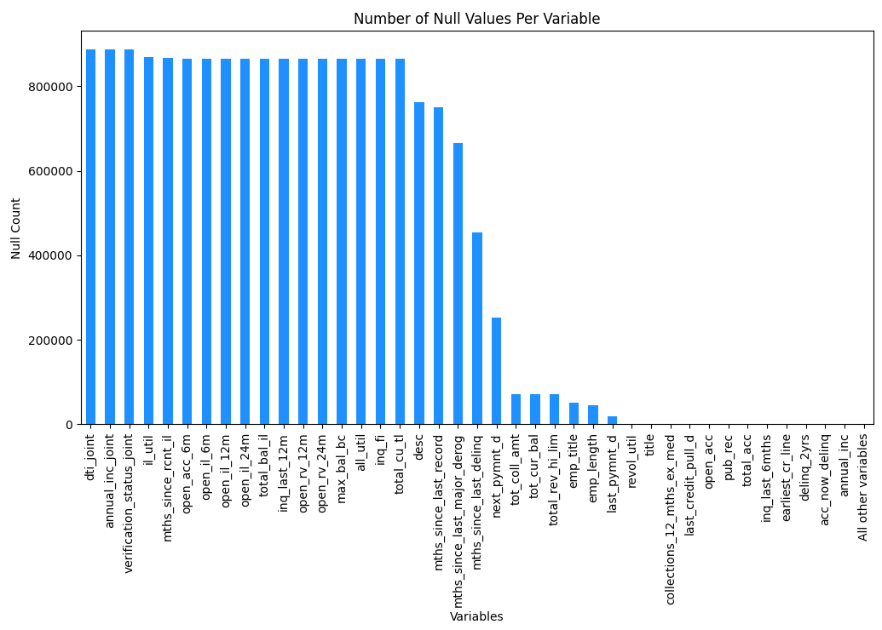
Data Cleaning
Deleted columns with over 800,000 null values
Deleted unimportant columns (url, id)

Slide 6

Descriptive Trends

Slide 7
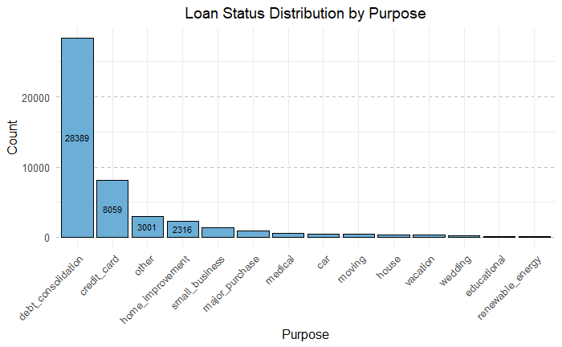

Slide 8
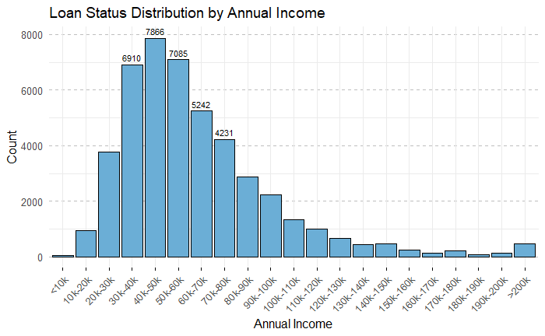

Slide 9
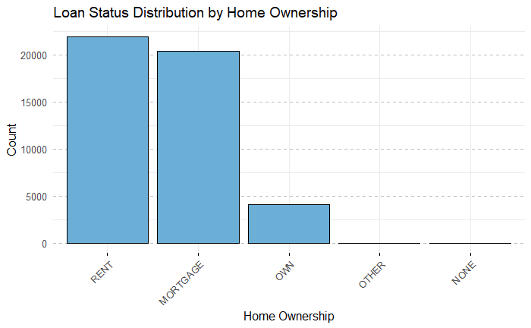

Slide 10
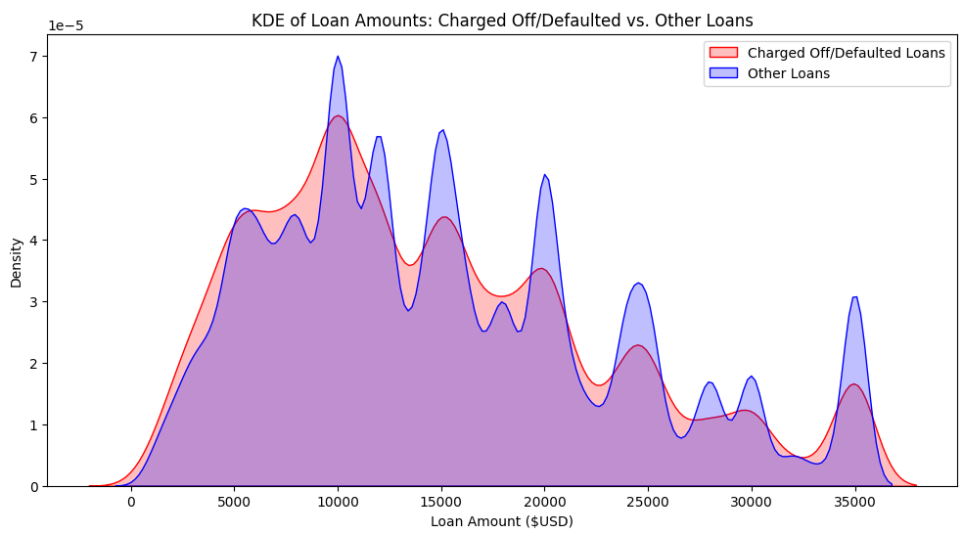
Loan Amount vs Status
KDE graph
Kernel Density Estimation
Visualize distribution smoothly
Bar chart was unclear
Similar distribution

Slide 11
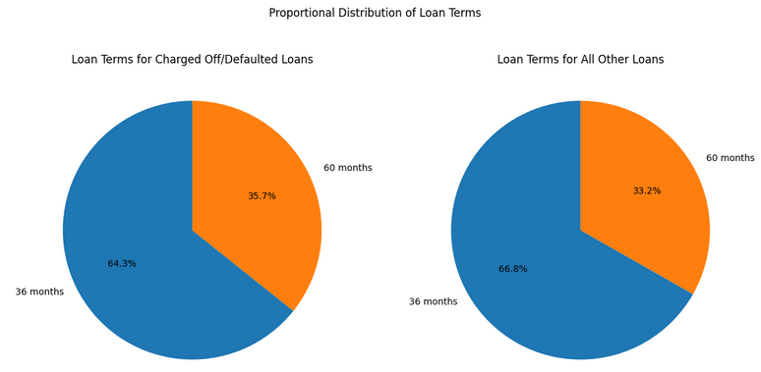
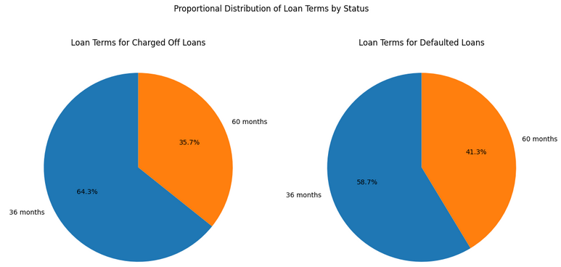
Loan Term vs Status
Pie chart
Similar proportions

Slide 12
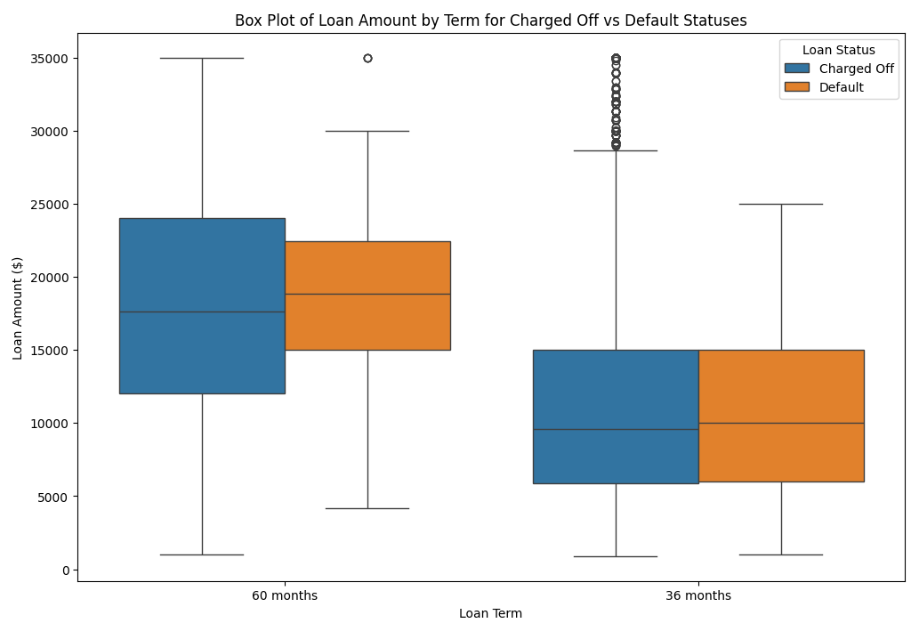
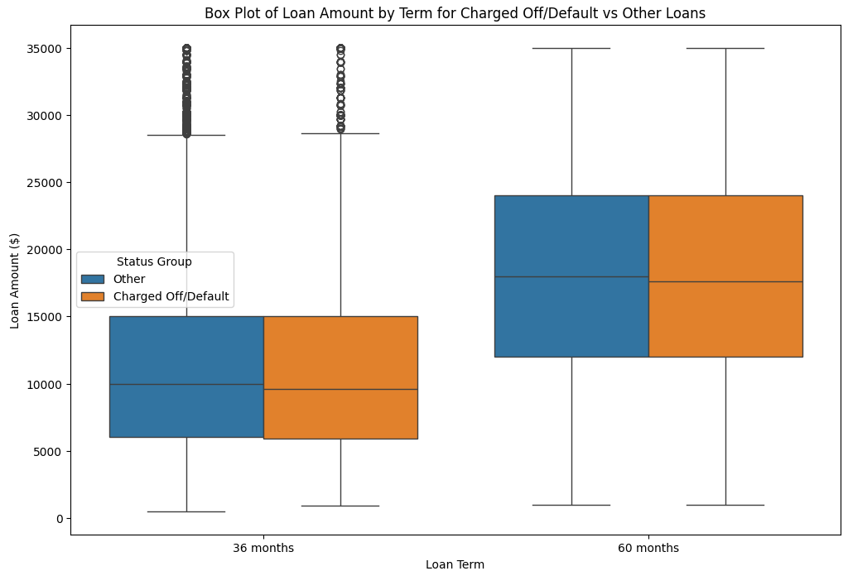
Loan Amounts by Term for Loans

Slide 13

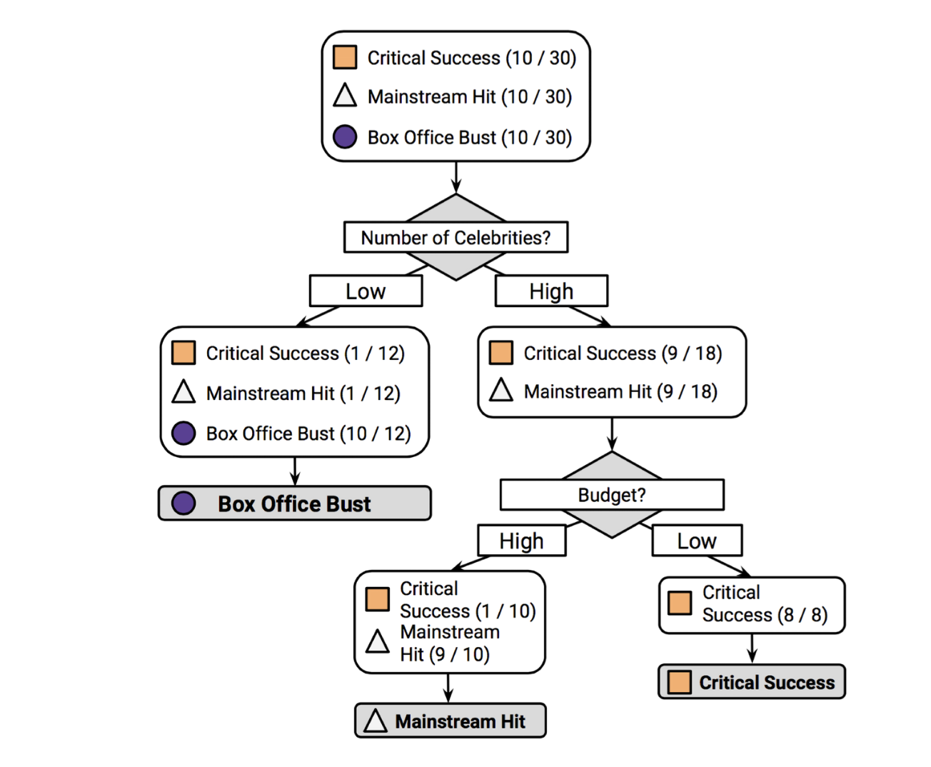
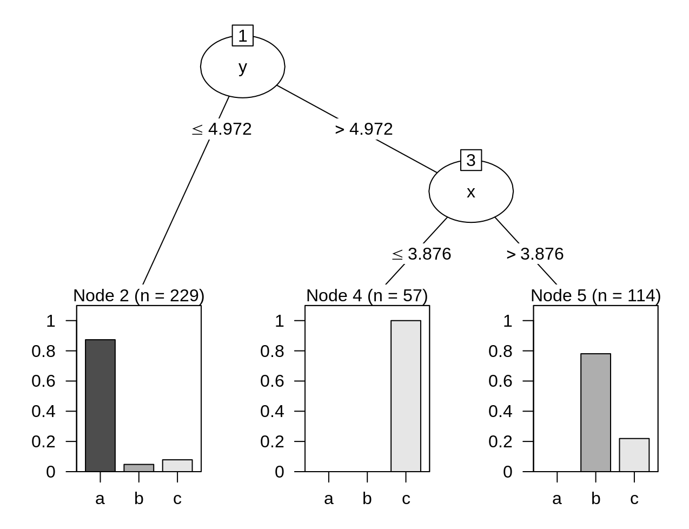
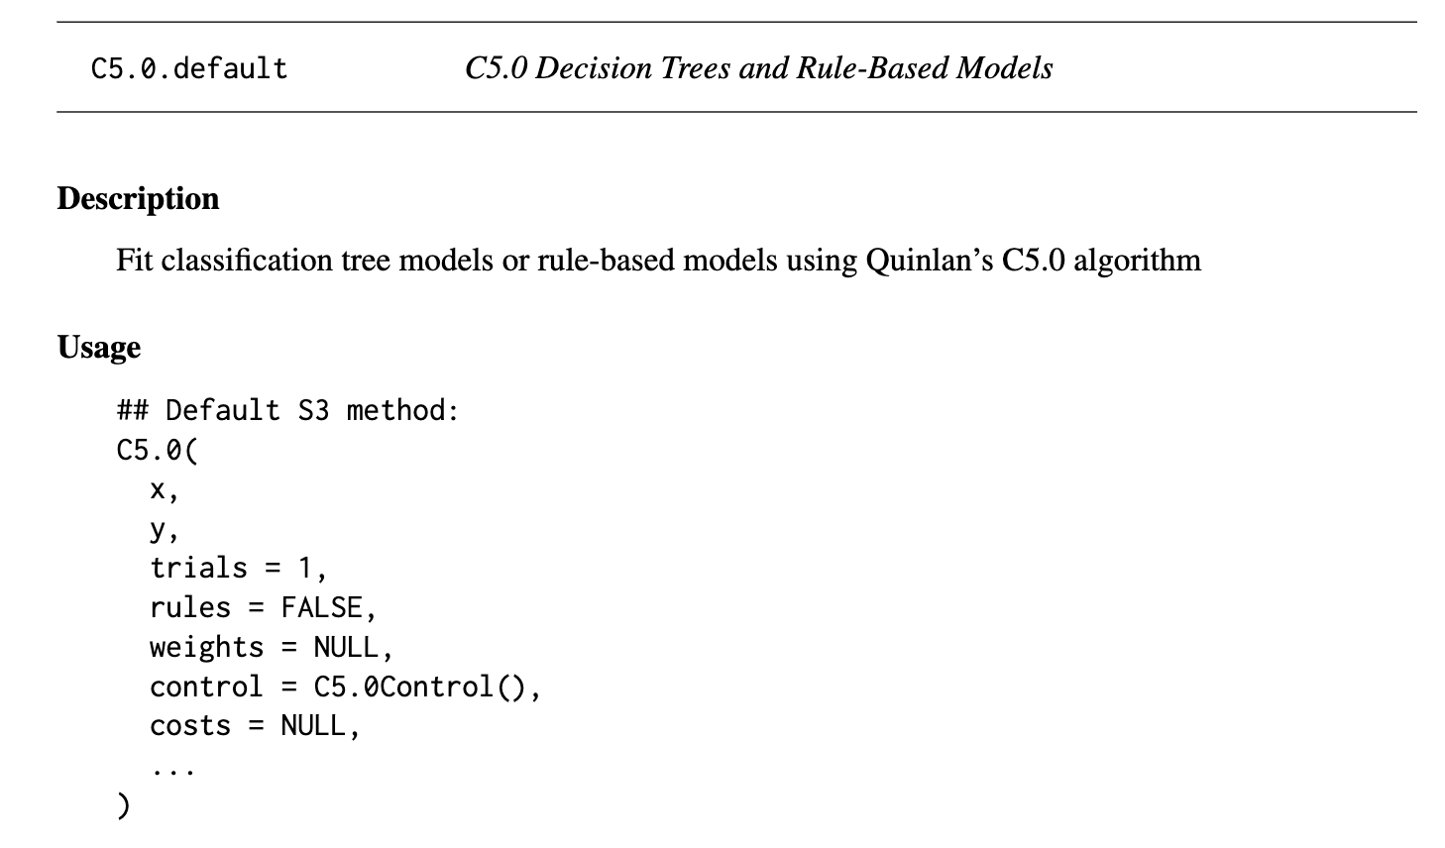

Modeling
C5.0
Wildly popular decision tree algorithm.
Utilizes an algorithm of recursive partitioning (divide and conquer)
Splits upon the feature most predictive of the target class
Benefits:
Can handle numeric, categorical, and missing data values
Automatically excludes unimportant features.
Very easy to interpret.
Easy to implement.
-> R Package C.50

Slide 14
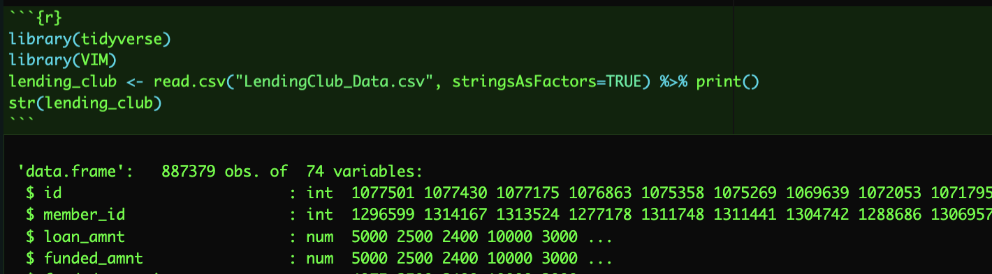
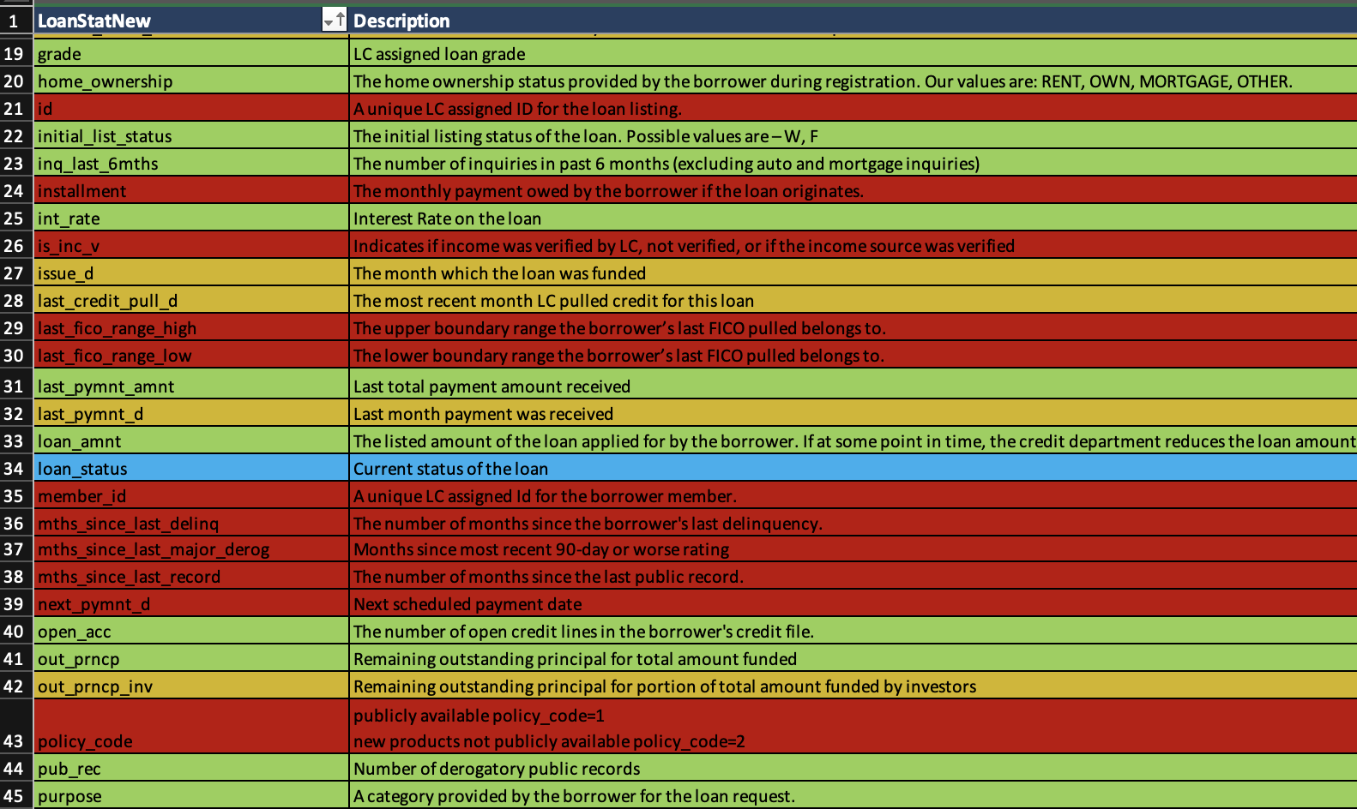
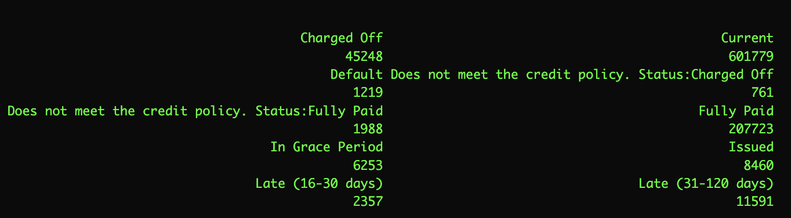

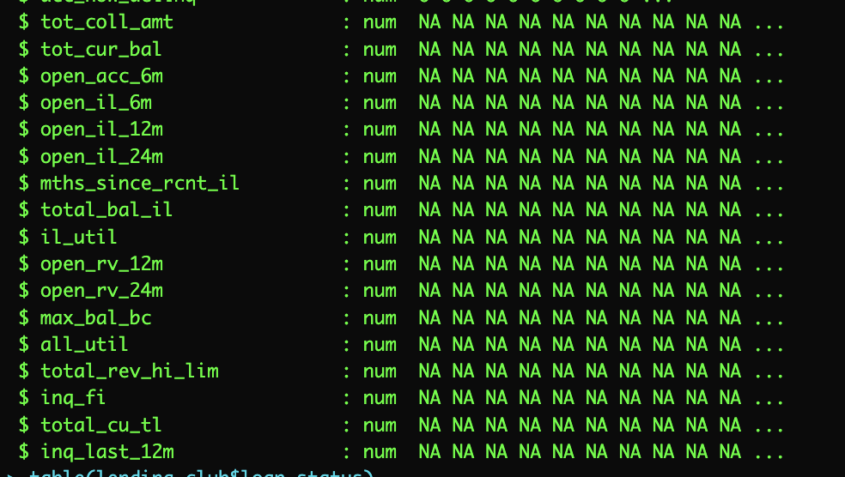
Step 1: Prepare the data
Red – Will not be used.
Yellow – Could be used, but with modification
Green - Promising as a predictor, and can be used

Slide 15
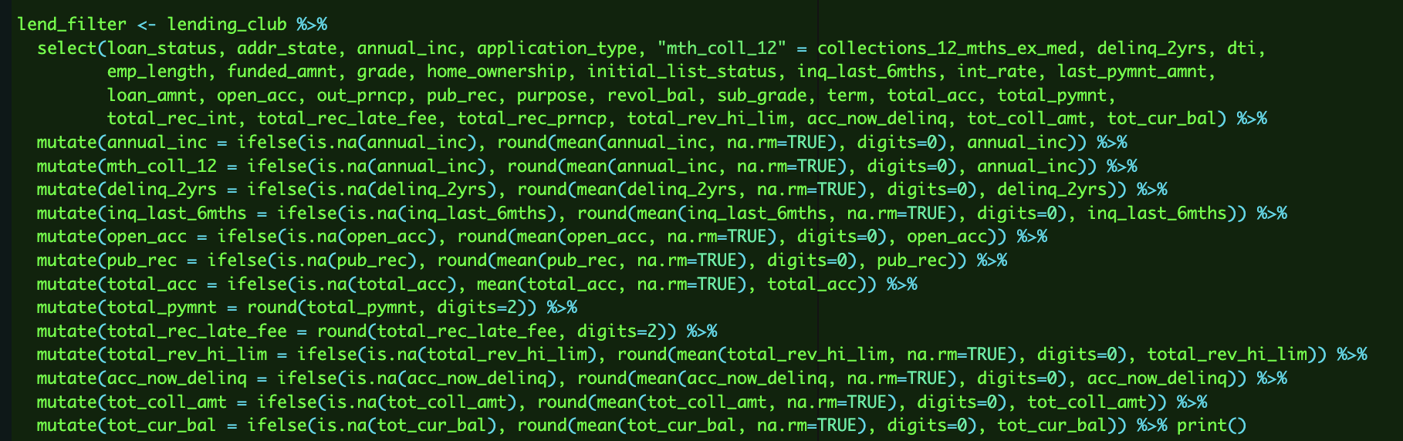
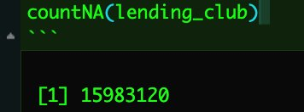
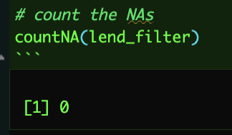
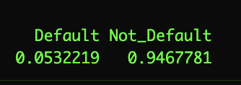
Purpose: Filter out every NA, and impute missing values with the means of the appropriate columns.
Heavy usage of ifelse statements to mass-replace NA values with the means of their columns.
Rounding to two decimal places in the cases of dollar values.

Slide 16
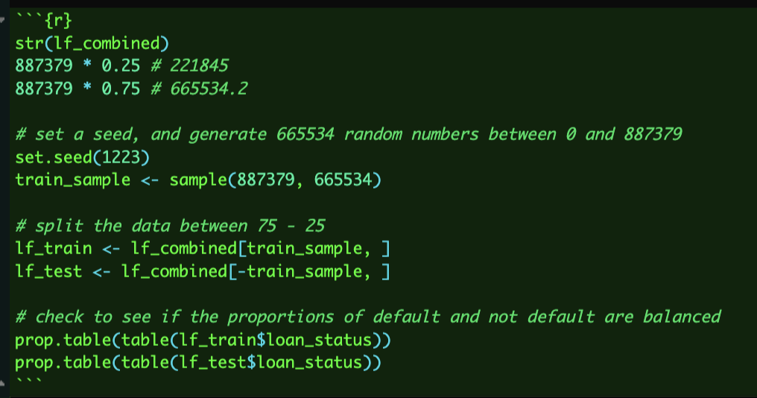
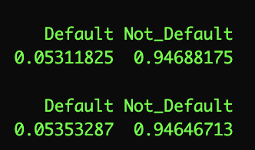
Step 2: Divide the dataset
It is crucial that the proportion of defaults and not defaults are equal in the testing and training dataset.

Slide 17
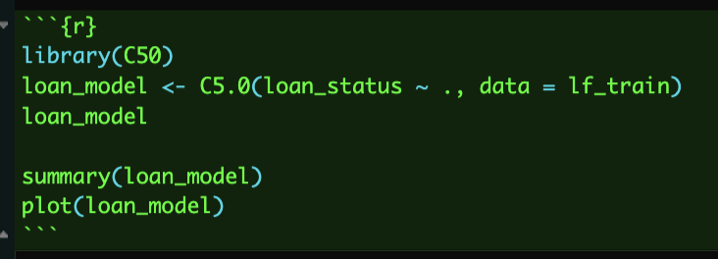
Step 3: Train the Model
Load in the C5.0 library in R.
Run a C5.0 algorithm on the training data, with loan_status as the target class
Print a summary of the loan model.

Slide 18
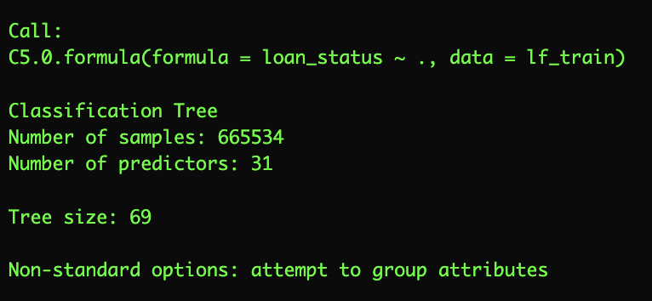
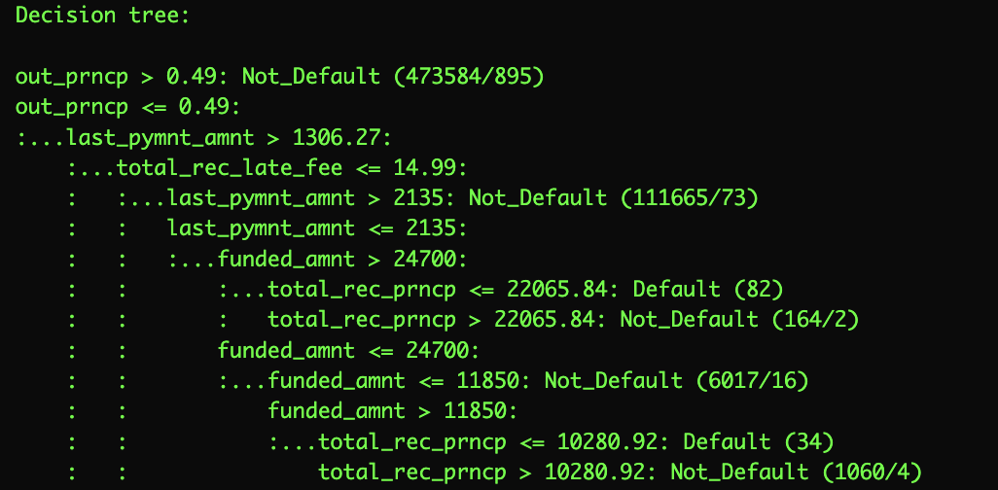
Step 3: Train the Model
Critically Thinking
In plain English:
If the outstanding principal is greater than 0.49 (the borrower has repaid more than 51% of the original loan), classify as “not default.”
Else, if the outstanding principal is less than 51%...
and the last total payment amount is greater than 1306.27...
and the total recorded late fee is less than 14.99...
And the last total payment amount is greater than 2135...
...classify as "not_default."
69 decisions.

Slide 19
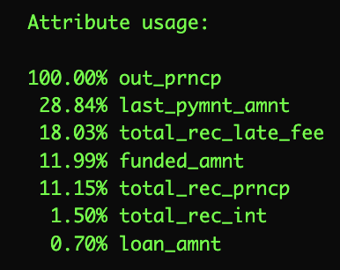
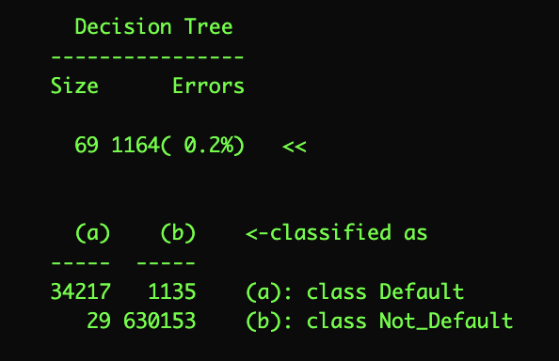
Step 3: Train the Model
Critically Thinking
In plain English:
If the outstanding principal is greater than 0.49, then classify as "not_default."
Else, if the outstanding principal is less than 0.49...
and the last total payment amount is greater than 1306.27...
and the total recorded late fee is less than 14.99...
And the last total payment amount is greater than 2135...
...classify as "not_default."
69 decisions.
Of the 665534 cases in the training data, 1164 were misclassified for an error rate of 0.002%! (Accuracy of 99.8%!)

Slide 20
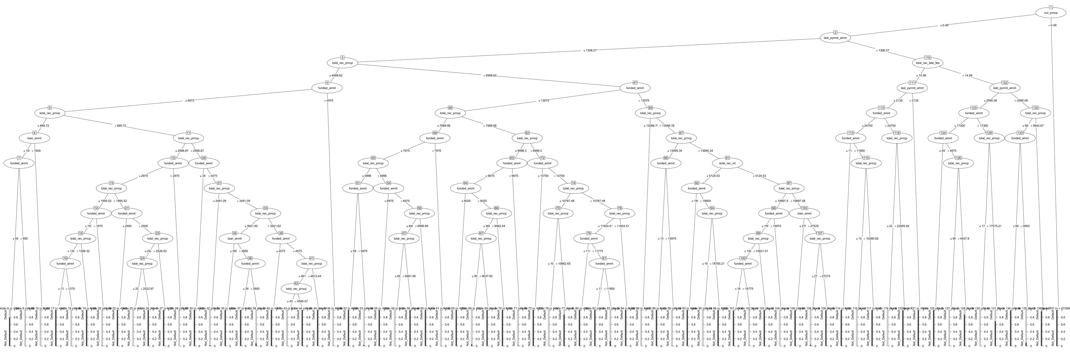
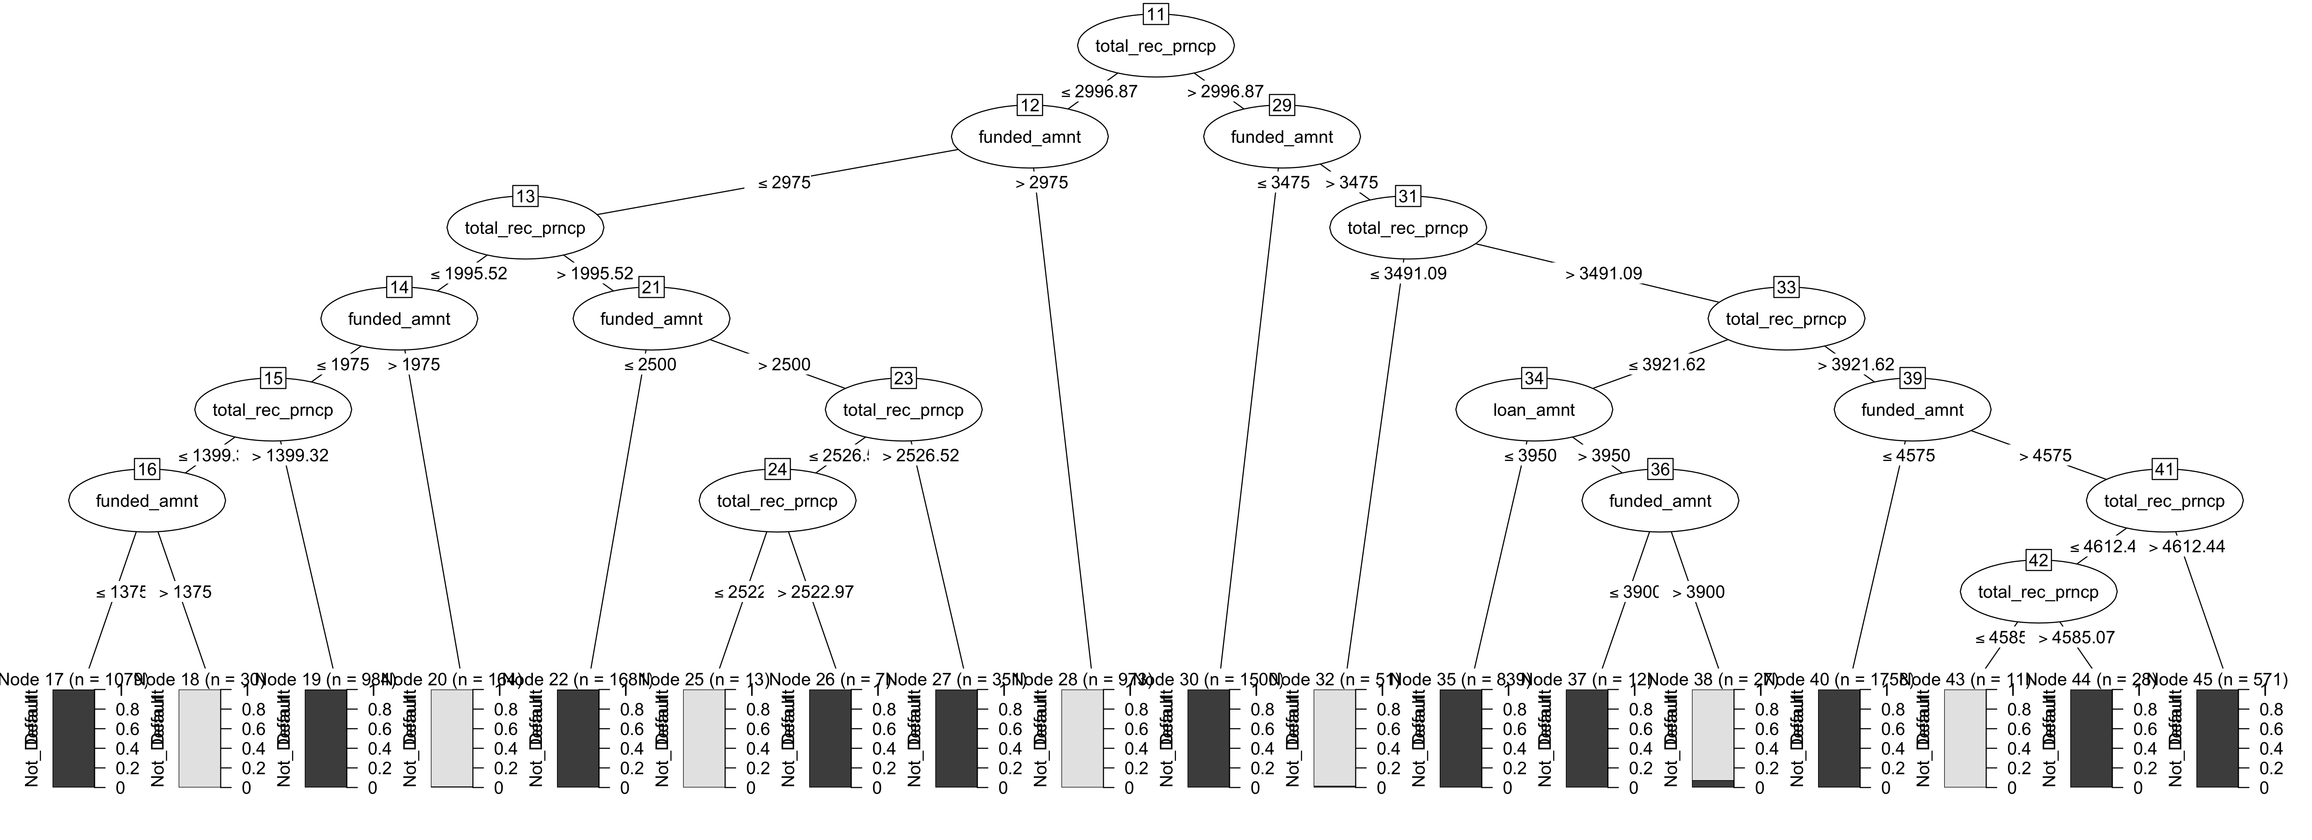
Step 3: Train the Model

Slide 21
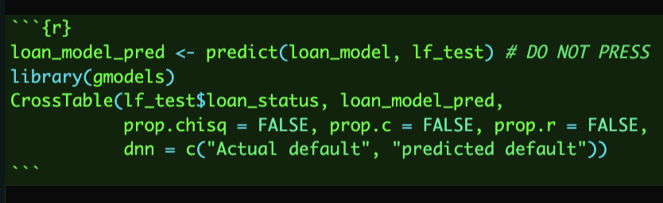
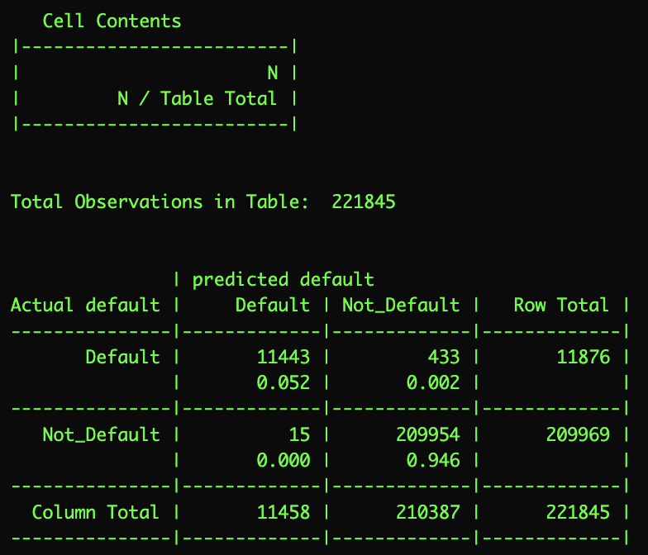
Step 4: Evaluate the Model
Test data: 221845 observations
11443 + 209954 = 221397
433 + 15 = 448
448 / 221397 = 221845
Still an error rate of 0.002!
99.8% accuracy!

Slide 22
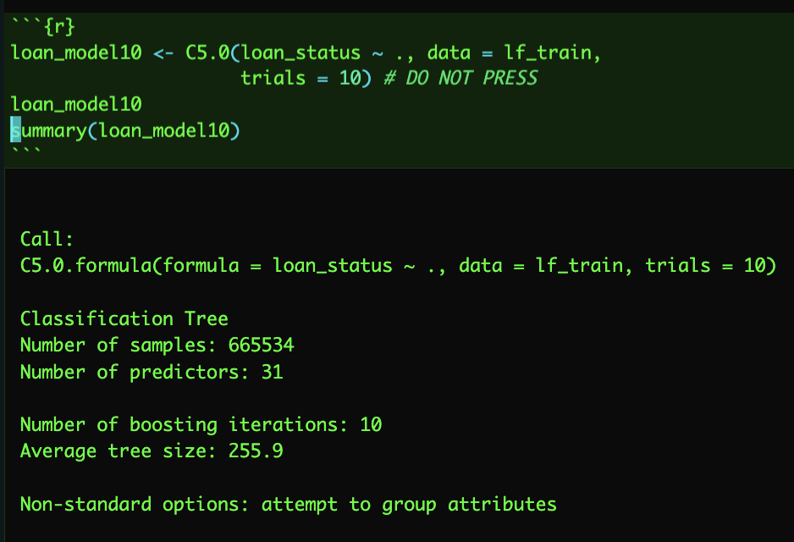
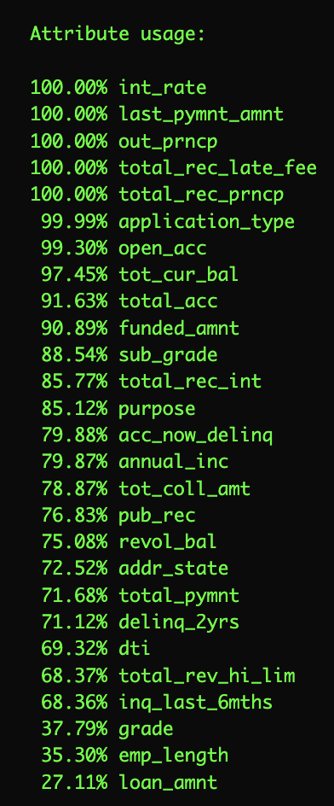
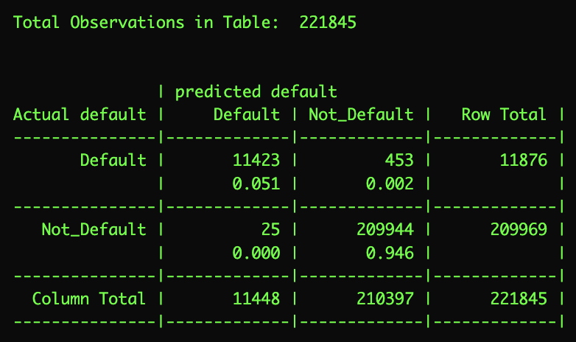
Adaptive Boosting – 10 Trials
Create ten weak-performing learning trees, each focusing on misclassified instances.
Trees vote for its best predicted class
Tree Size increases to 256.
Suspected overfitting; trees might be becoming too complex.
Unsure of the precise mechanism:
Interest rate, last payment amount, outstanding principal, total received late fee, total received principle most important attributes for predicting defaults.

Slide 23
Adaptive Boosting – 10 Trials
The boosted model did worse.

Slide 24

Prescribe and Recommend:
Based upon the model, three key factors that may contribute to a loan being unsuccessful may include:
If less than 51% of the loan has been repaid.
If the last payment amount received was more than 1306.27 USD.
If the total received principals is less than 22065.84
In order to encourage successful loan paying behavior, potential strategies may include:
Encourage borrowers to more frequent methods of loan payments, such as on a monthly basis. Encourage or offer bonuses for those borrowers who make extra loan payments.
Large loan payments may be a sign of financial hardship on the borrower. Banks can undertake initiatives such as financial education and early intervention systems to identify at-risk borrowers and offer assistance to encourage loan repayments.
Outstanding principal can extend the repayment period. Offer flexible repayment plans that are specifically designed for the borrower’s financial situation to maximize chances of repayment.

Slide 25
Reflections
Chance
KDE graph was interesting. Nice big data set. Timeline was short and we are a man down, but we adapted to our challenges.
Clara
I would continue to extend and develop my C5.0 Decision tree, playing with different combinations of trials, subtree pruning, and variable types to see if they have significant impact on predictive power. Introducing a cost matrix for decisions that ‘cost’ more than others (a type II error, or false negative is much more costly for a bank than a type I error) would also be worthwhile experimenting with for our model. If I were to learn categorical variable encoding, an ANN would likewise be very fun.
Addison
Enjoyed learning about how loans work! In terms of descriptive visualizations I would’ve liked to focus more on time periods of making loans and if certain months, years, had various increase/decrease.

